Slide 1
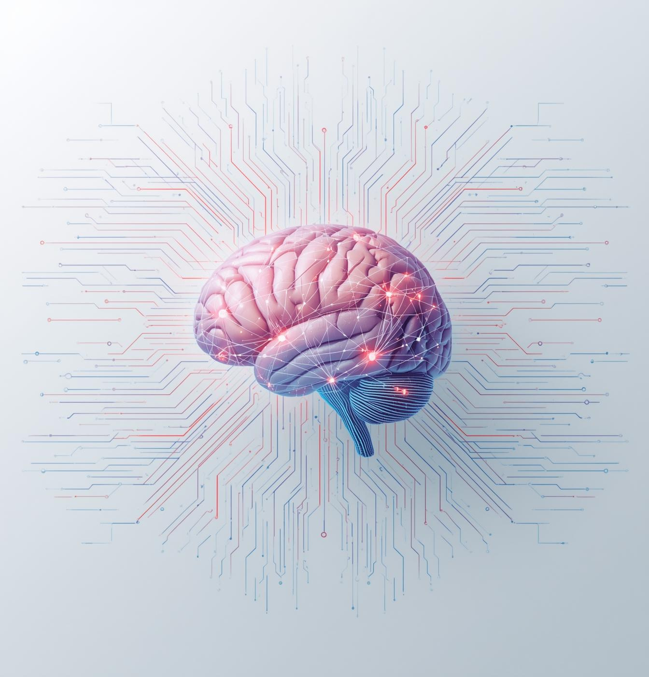

09 Jan 2026
Introduction to NLP
Applied Natural Language Processing

Slide 2
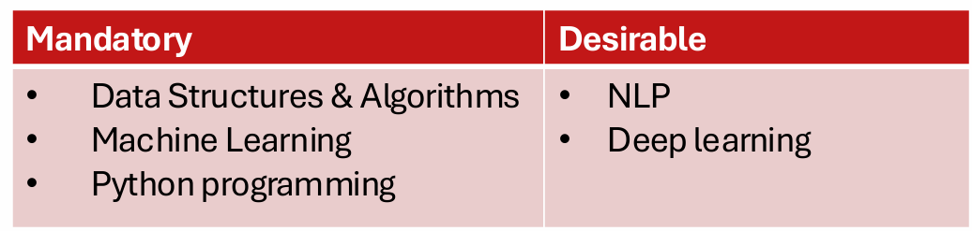
Prerequisite for the course

Slide 3
Technical Requirement
Programming Language: Python
IDE: Colab/VS studio/Jupyter notebook
Libraries: NumPy, Pandas, Matplotlib, scikit-learn, Keras, PyTorch/TensorFlow

Slide 4
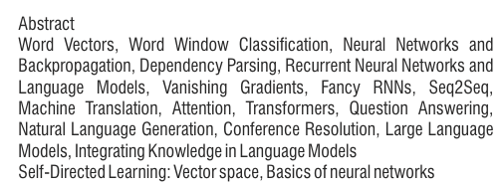
Course Content

Slide 5
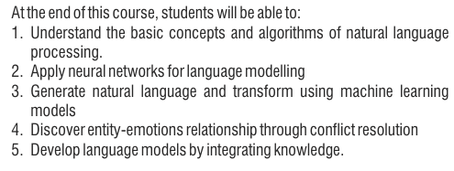
Course outcomes

Slide 6
References
Books (optional reading)
• Speech and Language Processing, Dan Jurafsky and James H. Martin
https://web.stanford.edu/~jurafsky/slp3/
• Natural Language Processing, Jacob Eisenstein
https://github.com/jacobeisenstein/gt-nlp-class/blob/master/notes/eisenstein-nlp-notes.pdf
• A Primer on Neural Network Models for Natural Language Processing, Yoav Goldberg
http://u.cs.biu.ac.il/~yogo/nnlp.pdf
• Journals
Computational Linguistics, Natural Language Engineering, TACL etc.
• Conferences
ACL, EMNLP, NAACL, COLING, ICML, NeurIPS, ICLR, AAAI, WWW etc.

Slide 7
Evaluation Scheme
Mid-term – 30 Marks
Internal – 20 marks
External – 50 marks

Slide 8
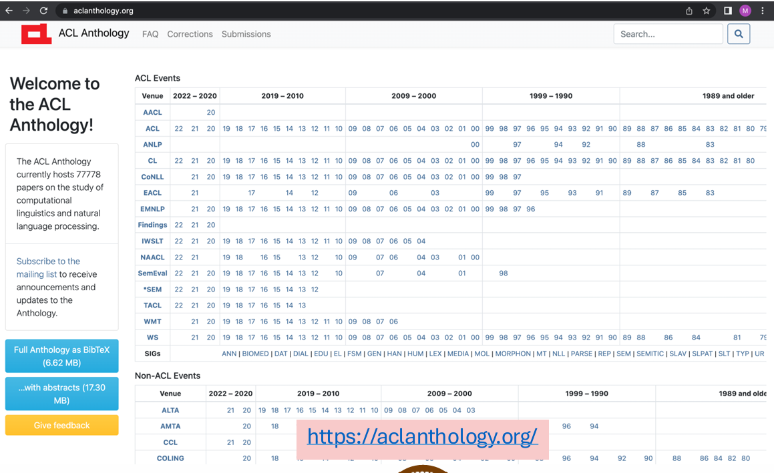
Research Papers Repository

Slide 9
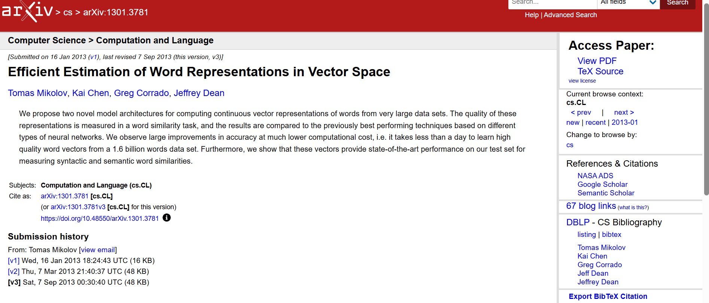
Research Papers

Slide 10
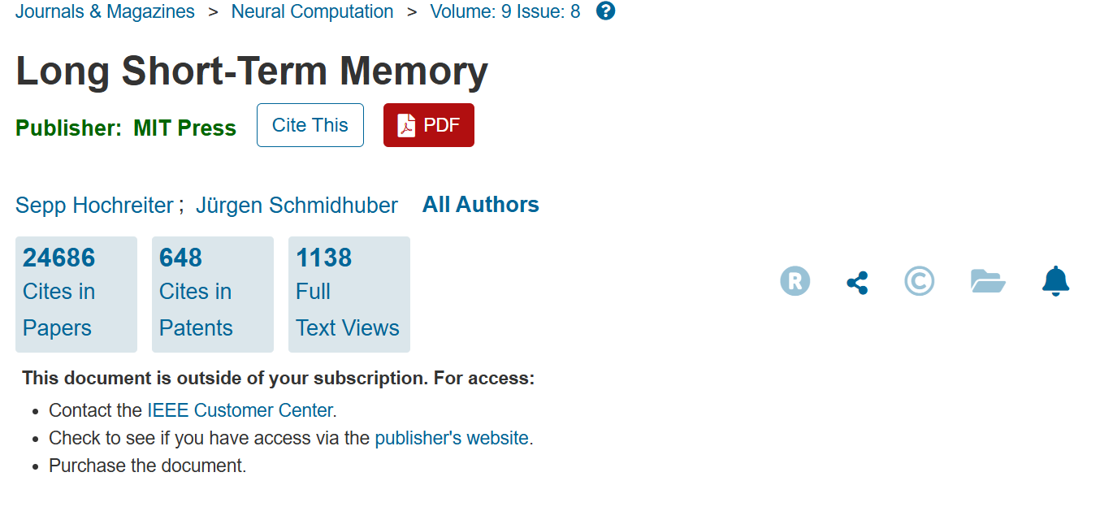
Research Papers

Slide 11
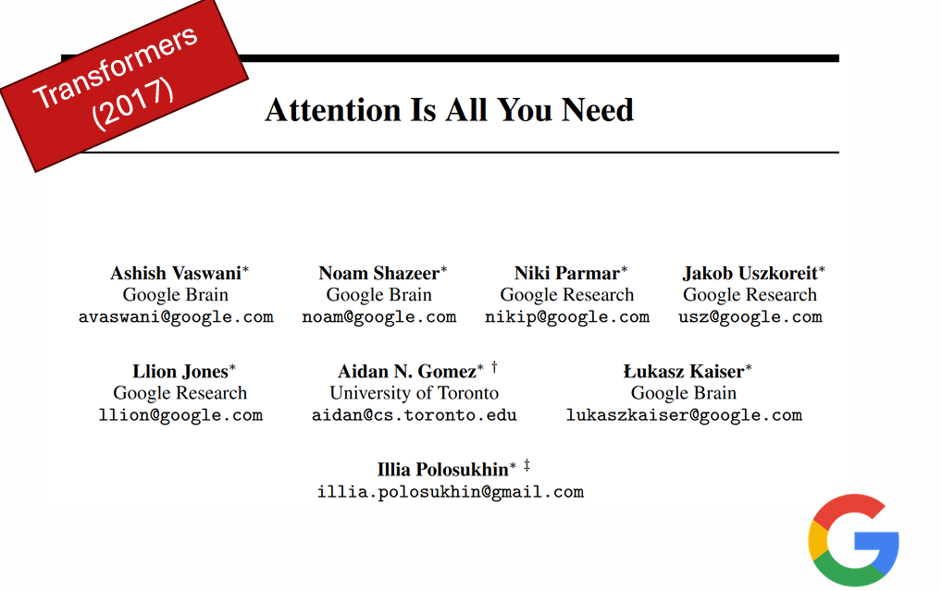
Research Papers

Slide 12
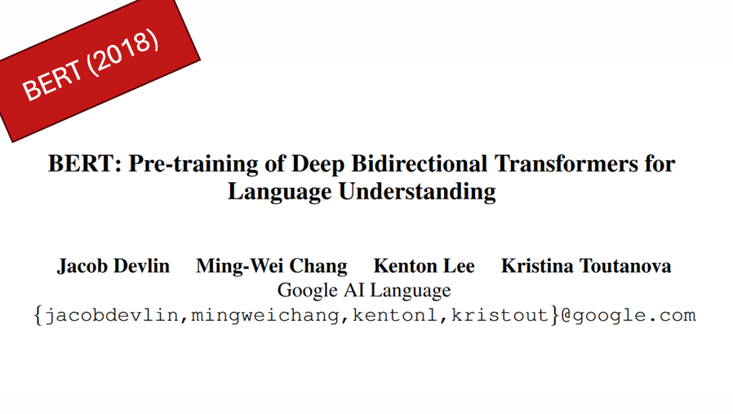
LM Era

Slide 13
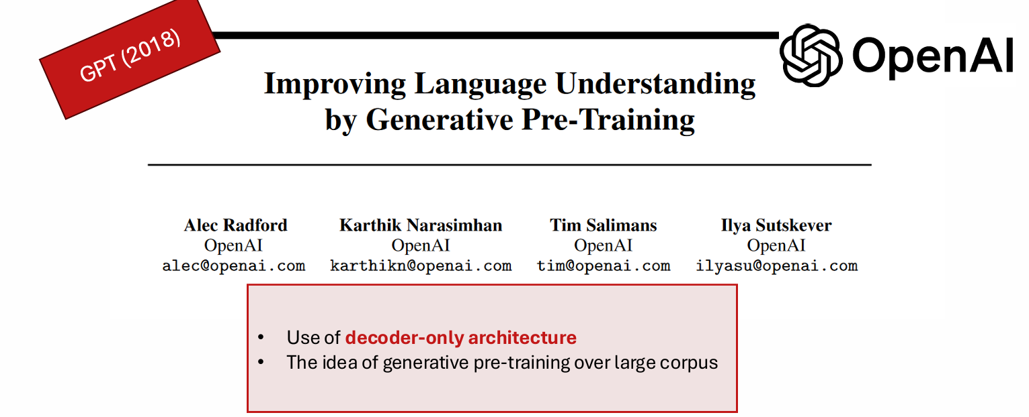
LM Era

Slide 14
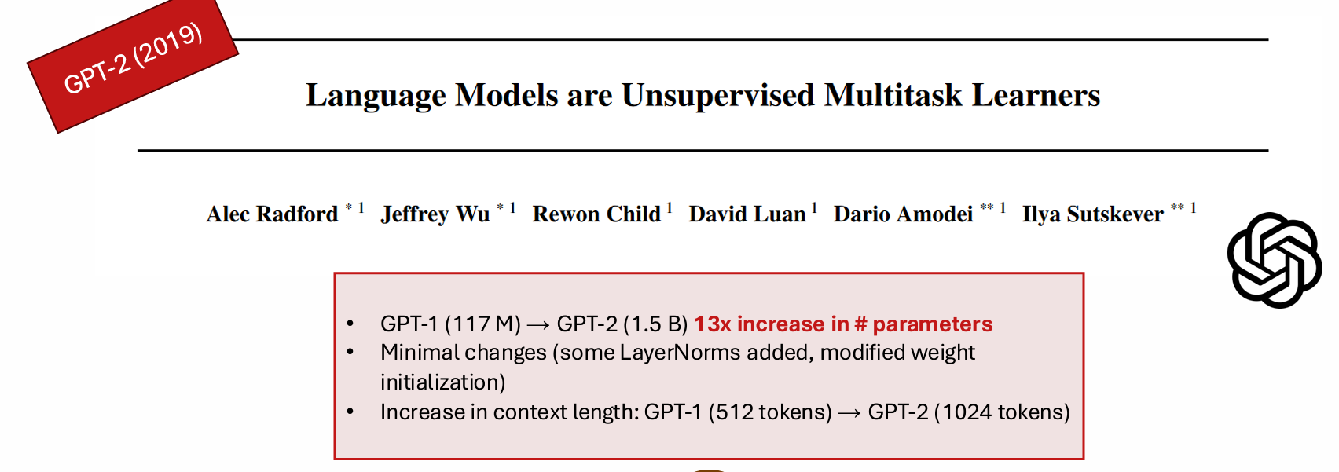
LM Era

Slide 15
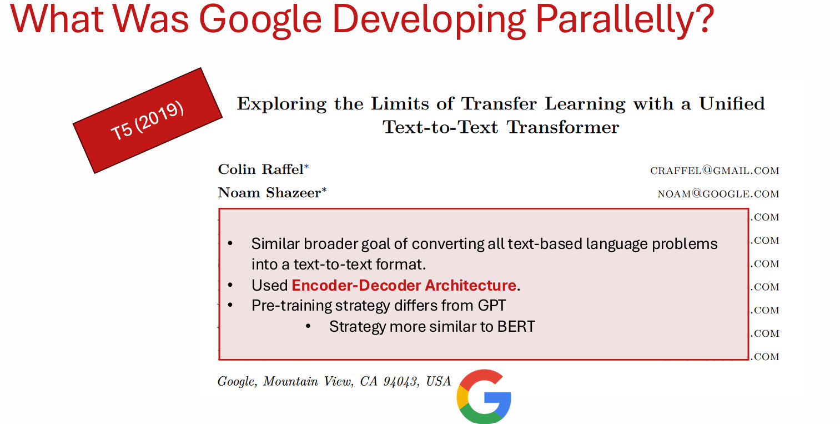
LM Era

Slide 16
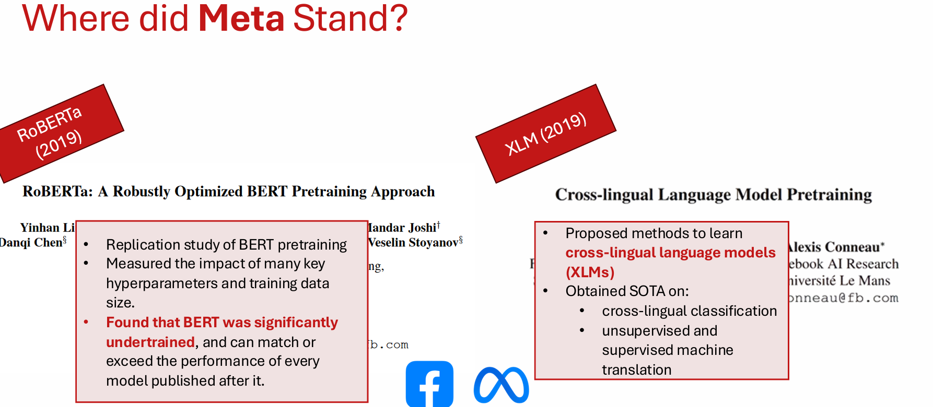
LM Era

Slide 17
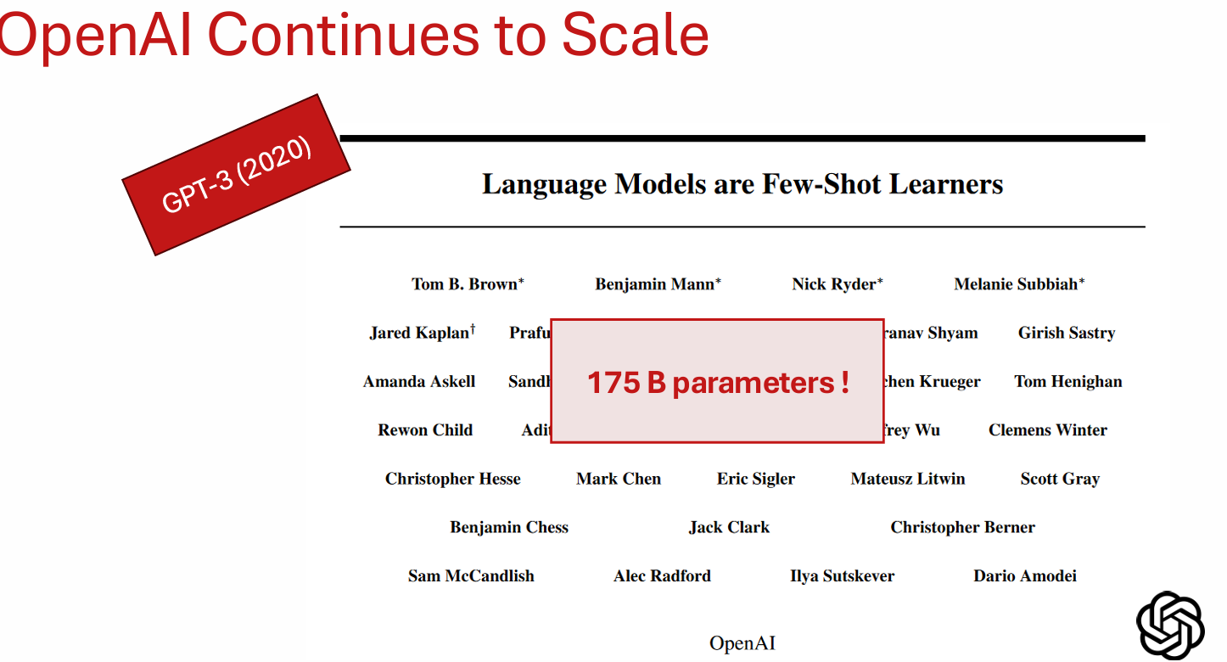
LLM Era

Slide 18
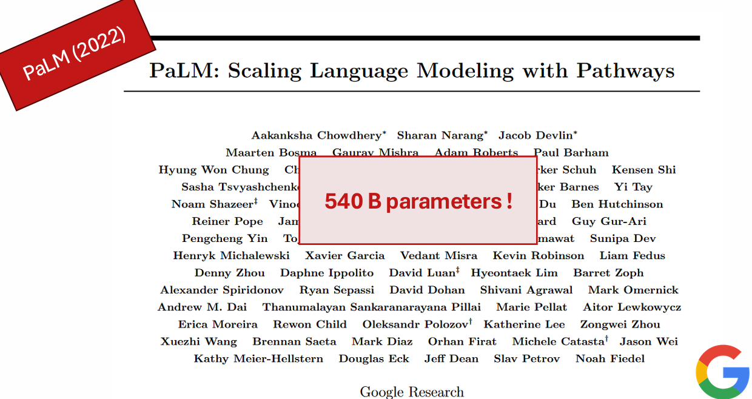
LLM Era

Slide 19
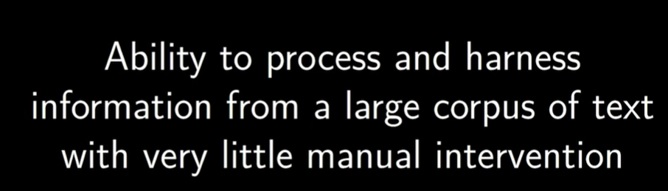
Goal of NLP

Slide 20
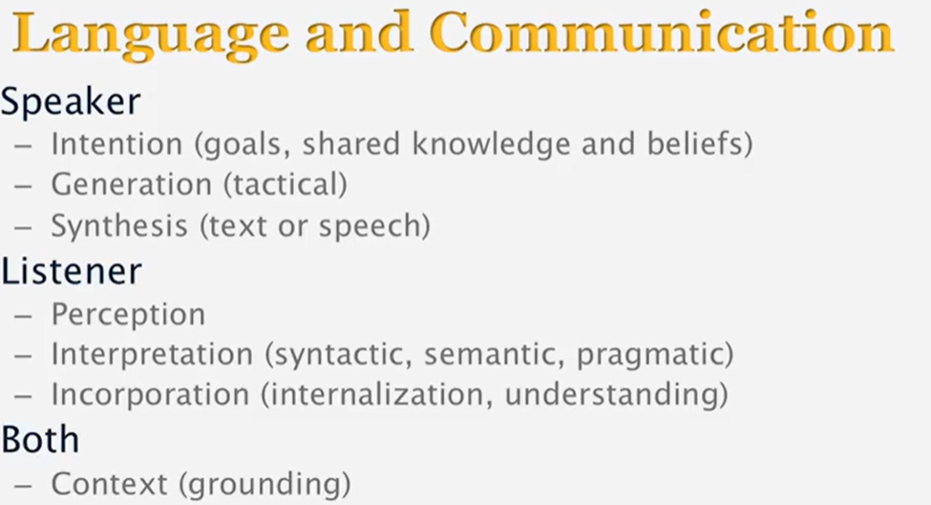
Steps in Language Communication

Slide 21
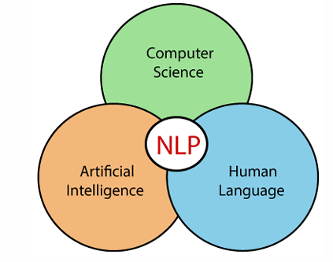
What is NLP
Natural Language Processing (NLP) is the field of AI that enables machines to:
Read
Understand
Interpret
Generate human language

Slide 22
Can Machines Understand?
When humans understand language, we use:
Life experience
World knowledge
Emotions
Common sense
Cultural context

Slide 23
Can Machines Understand?
What Machines Actually Do
A machine:
Converts words → numbers
Finds patterns
Predicts the most likely meaning
👉 No emotions.
👉 No Context.
👉 Only probabilities.

Slide 24
Can Machines Understand?
“I saw her duck.”
“Great, another Class.”
“The movie is not bad.”

Slide 25

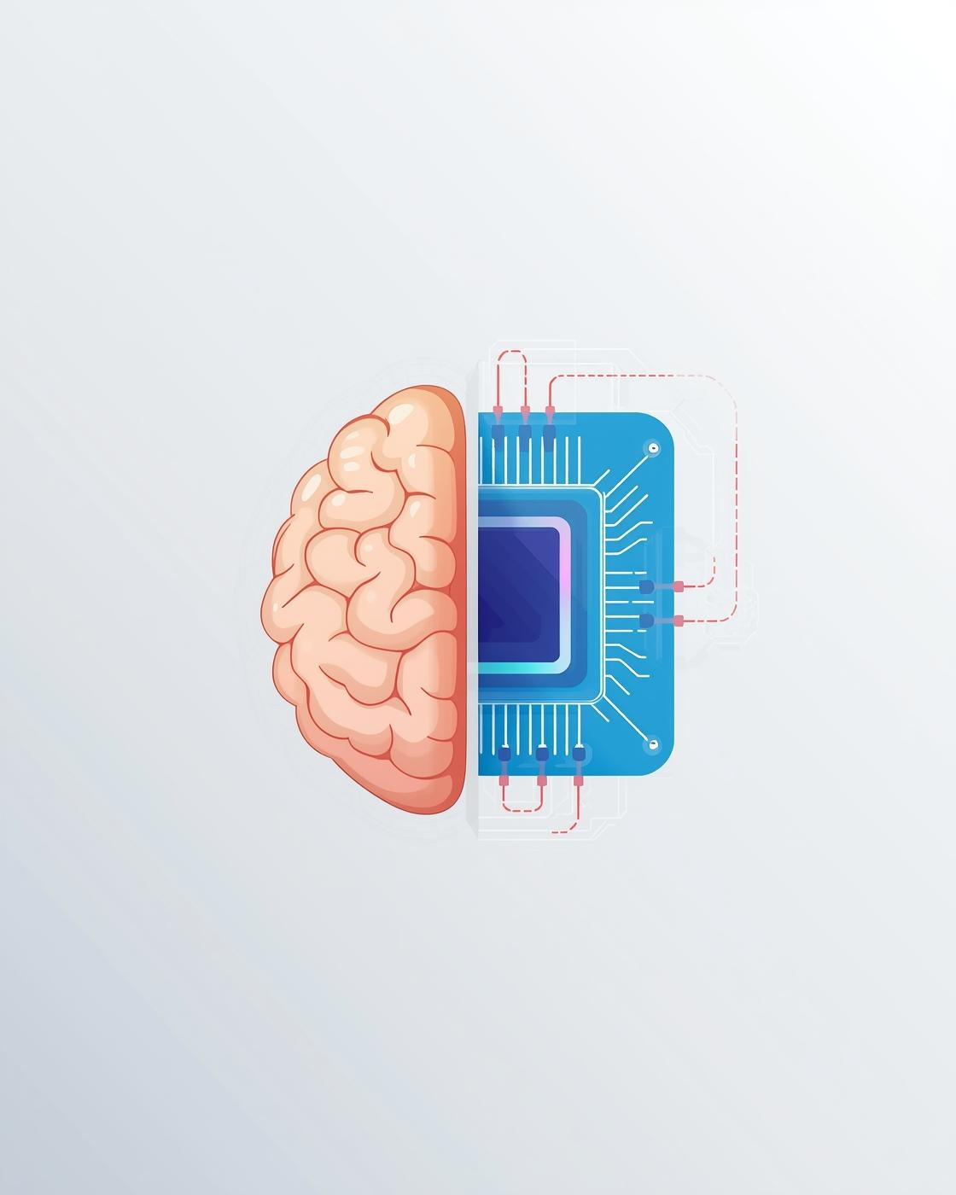
Why NLP is Hard

Slide 26

The Ambiguity In Language
Understanding the sentence "I saw the man with the telescope" showcases how context can lead to multiple interpretations.

Slide 27
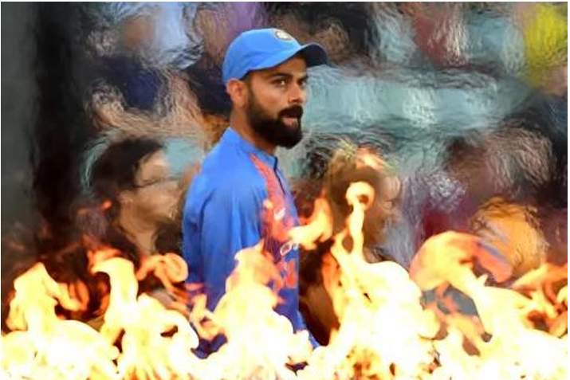
The Ambiguity In Language
Virat Kohli was on fire last night

Slide 28
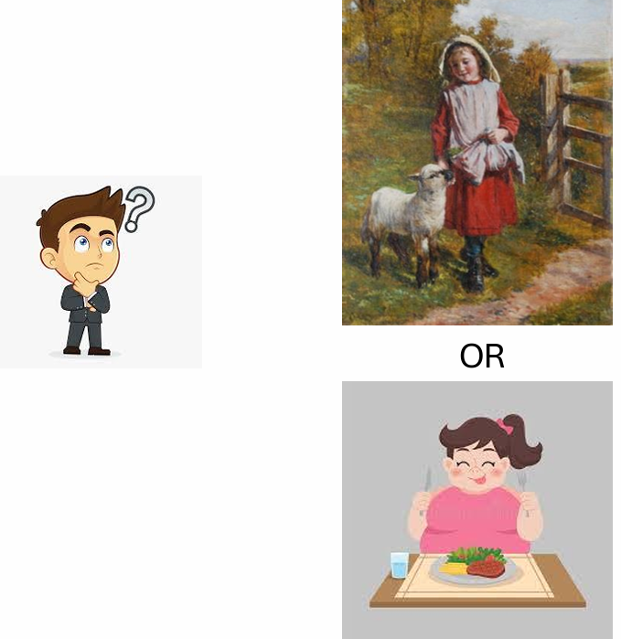
The Ambiguity In Language
Mary had a little lamb.
Mary was physically bringing a lamb to a
location, such as a farm or a home
Mary ate a lamb
Mujhe aapko mithai khilani padegi.

Slide 29
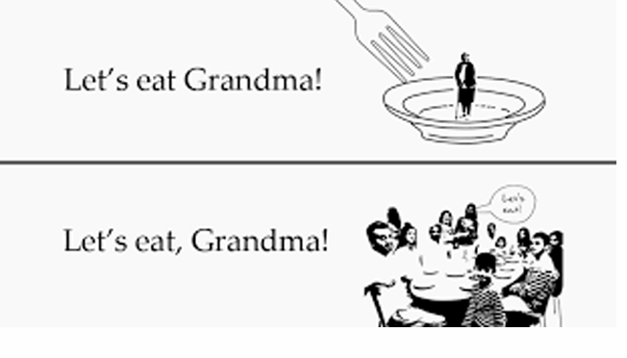
Ambiguity and Punctuations!

Slide 30
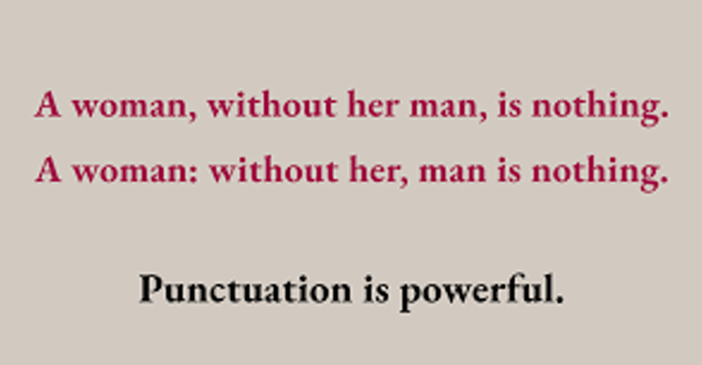
Ambiguity and Punctuations!

Slide 31
Ambiguity in words
Polysemy:
Bank
Light
Run
Letter

Slide 32
Other Issues
Non-standard English: BTW, HRU, GM, etc
Use of Idioms: dark horse, get cold feet
Neologisms: bromance, Brunch

Slide 33

Real-World Applications of NLP

Slide 34
Search Engines & Information Retrieval
Chatbots & Virtual Assistants
Sentiment Analysis (Opinion Mining)
Hostile content detection
Machine Translation
Speech-to-Text & Voice Interfaces
Question Answering Systems
Text Summarization
Emotion & Intent Detection
Text Generation & Content Creation

Slide 35
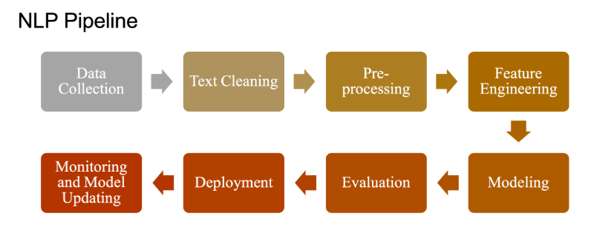
NLP Pipeline

